Slide 1


Navigating

Slide 2


Training Agenda
Course Learning Outcomes
What is CCC Confer?
Get Started with MyConfer
Beginning a Session
Sharing Content
Record
Timer
File transfer
Video camera
Resources
Today’s trainers:
Michelle Taramasco
Donna Gustafson

Slide 3
Course Learning Outcomes
Present a 10 minute session in which you demonstrate your ability to:
Upload and navigate a brief PowerPoint presentation.
Use the Whiteboard tools to highlight content, insert text, draw, and use to the pointer for screen focus.
Use Application Sharing to share desktop applications in ‘Share desktop’ mode and individual applications.
Host a Web Tour to YouTube and share the URL in Chat.
Create a multiple choice Poll and publish results to the Whiteboard.

Slide 4





What is CCC Confer?
Online e-conferencing solution for live and recorded meetings and classes.
Funded by the California Community College Chancellor’s Office.
No $$$ to California Community Colleges, staff or students.
Live support and help desk - located at Palomar College in San Diego County.

Slide 5
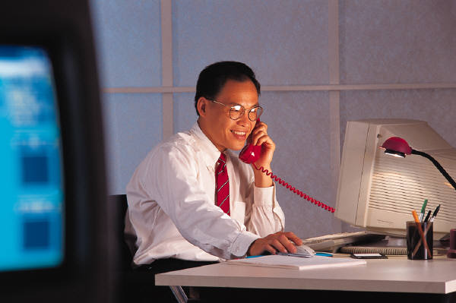


Communication tools
Available in all meetings and classes
Telephone
Toll-free conference line
VOIP use the internet to talk
Text chat non-verbal communication.

Slide 6
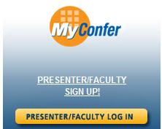
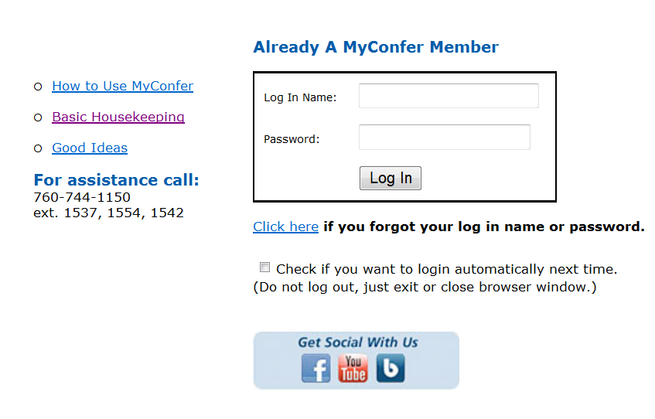
MyConfer
Sign up to create an account
Log in and start working!
Log in to schedule, edit or cancel meetings.
Connect to your meetings.
Update your profile.

Slide 7
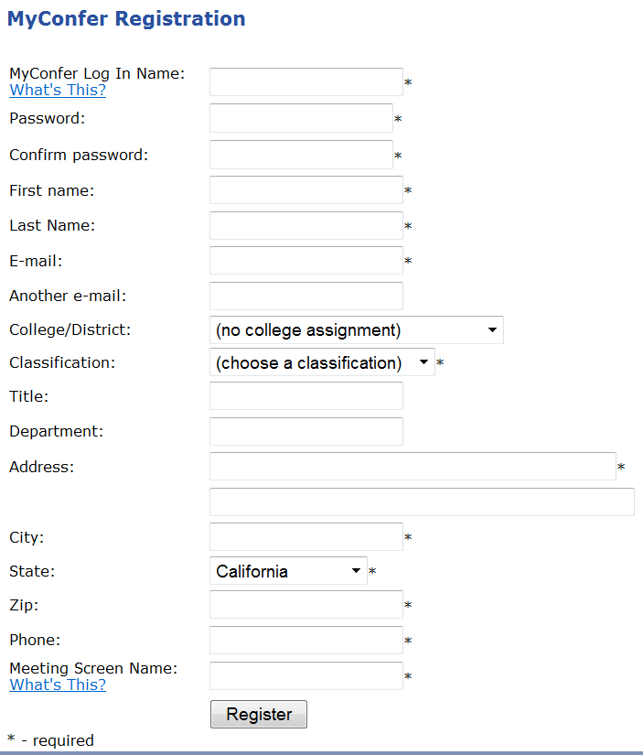

Register
* required entry
Important fields:
Login Name and Password.
All communications are sent to this E-mail address.
Choose a Classification except ‘Student’ or ‘Other’.
Very important! The best Phone number to reach you .
The Meeting Screen Name is how your name should appear when you log into your meeting.

Slide 8
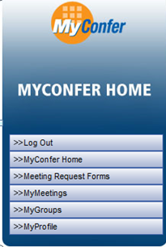
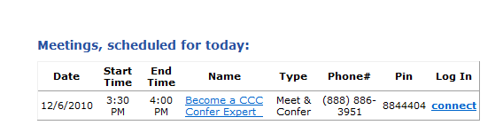
Using MyConfer
1
1 Log out
2 Home page – connect to today’s meetings
3 Schedule meetings
4 Review, edit or cancel scheduled meetings
5 Add or remove group/college affiliations
6 Update your profile details
2
3
4
5
6

Slide 9
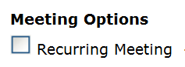
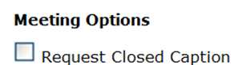





Scheduling Options

Slide 10
Beginning a Session
Room View
Communication Tools
Moderator & Participants Panel
Record
Closed Caption
Privacy Options

Slide 11

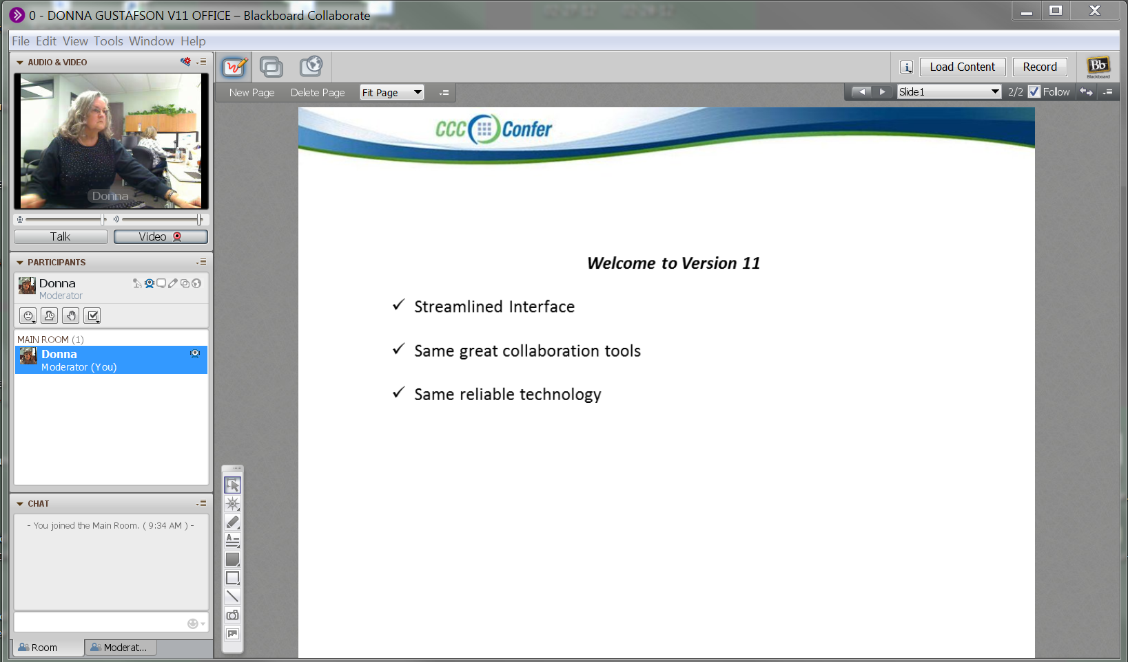

Room View
Whiteboard Window
Sidebar Panels
AppShare window
Load PPT Content
Start Recorder
Feature Menus
WebTour Window
Navigate Screens
Audio & Video Panel
Whiteboard Screens: Content Display
Global permissions
Participants Panel
Chat Panel
Whiteboard tools palette

Slide 12
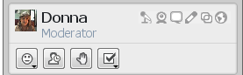
Moderator Permissions
1 2 3 4 5 6
Set for all moderators:
1 Audio VOIP
2 Web Cam
3 Chat
4 Whiteboard
5 App Share
6 Web Tour

Slide 13
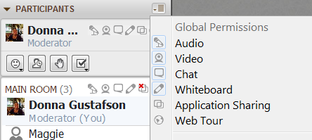
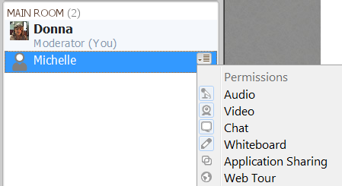
Participant Permissions
Change permissions for Everyone
Everyone can use these features - click to take away
Additional permissions - click to add / take away
Change permission for Individuals
Click on a name, then the drop down menu

Slide 14

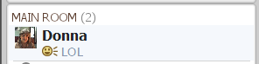
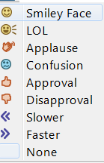
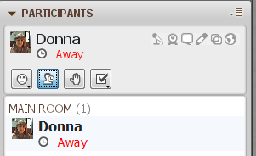
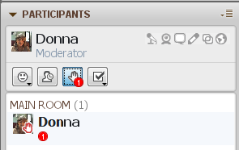
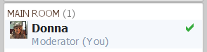
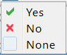
Participant Interaction
Emoticons
Stepped Away
Hand Raise
Poll Response

Slide 15
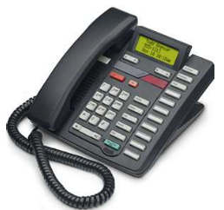
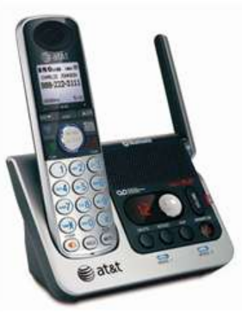
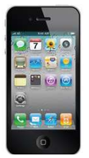

Telephone Communication
A toll-free number and passcode is assigned.
The Presenter code opens the line.
Conference features are listed in the confirmation.
The telephone & internet are separate technologies: if the internet fails, the meeting can continue over the phone.

Slide 16
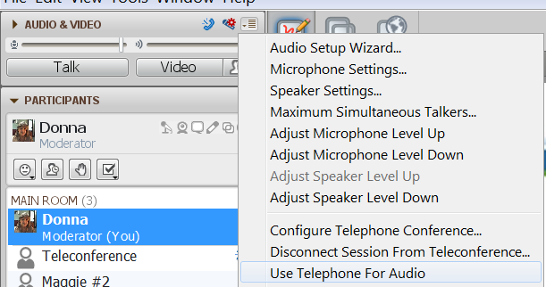
Telephone Communication
Anyone can indicate they are using the telephone – prevents audio feedback when the Teleconference Bridge is connected.
Note: ‘Connect Session to Teleconference…’ must be set up before option is available. This is covered in how to ‘Record‘ slides.

Slide 17

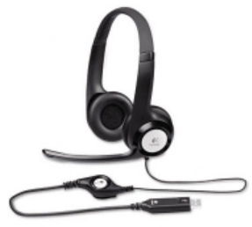
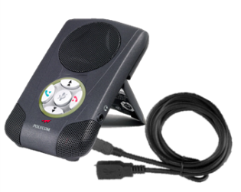
VOIP Communication
Moderators and Participants can use the computer like a telephone.
Plug in an integrated headset before connecting to the session.
Allow up to six simultaneous open mics.
VOIP and telephone can be used in the same session.

Slide 18
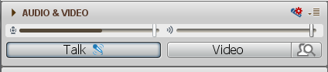
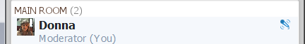
VOIP Communication
Step 1
Run the Audio Wizard
Step 2
Click on to Talk Click off when Done
Everyone knows who is talking
Option: Tools > Audio > Audio set up wizard

Slide 19
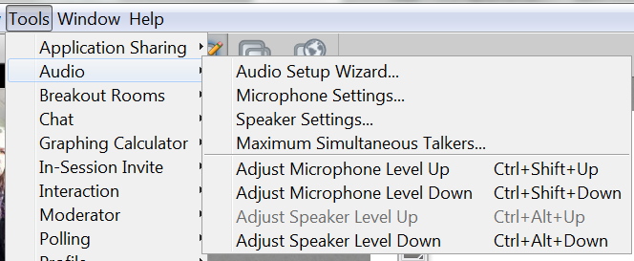
Audio Options
Note: Choose to allow up to 6 mics active at the same time!

Slide 20
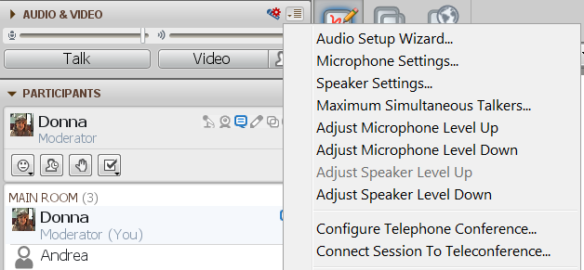
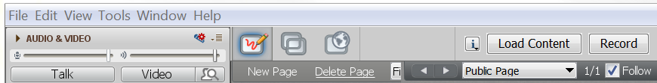
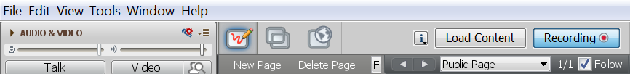
Record
Click drop down in the ‘Audio & Video’ panel
Step 1 Join telephone & room
Note: Step 1 not required when using VOIP only
Step 2 Start/Resume recorder
Step 3
Pause/Stop Recorder

Slide 21
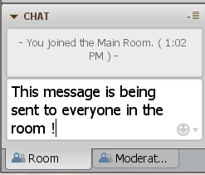
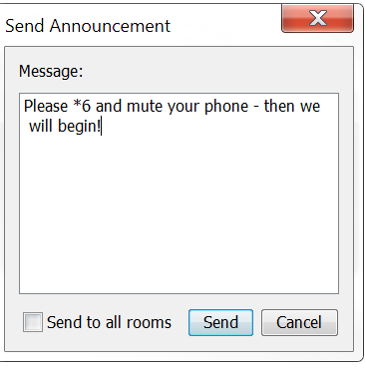
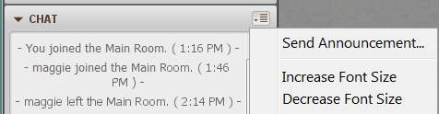
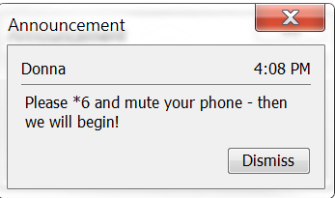
Group Chat
Enter your message & send to appear in the Chat window
Send Announcement -appears as a pop-up message

Slide 22
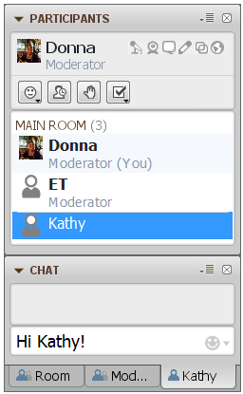
Private Chat
Double click on a name to initiate a Private Chat
Click on the recipient’s name tab
Type your message
Enter on your keyboard
Option: Click the drop-down next to a name and Select ‘Send a Private Chat’

Slide 23

Polling
Gather responses from your participants.
Use Yes / No polls for simple, or definitive responses.
Use Multiple Choice polls to offer specific response choices.
Keep the results private, or share everyone.

Slide 24
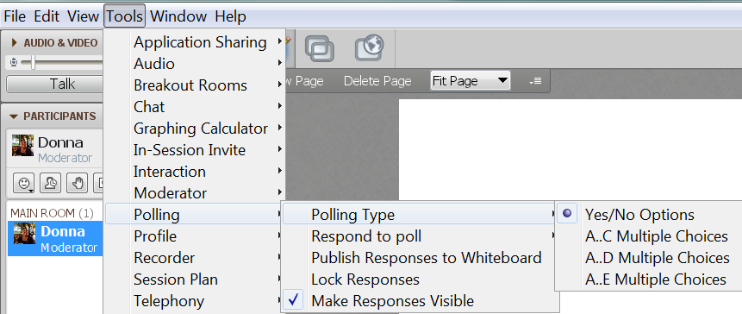
Poll Options
Select a Poll response type
Select viewing options.

Slide 25
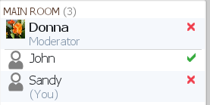
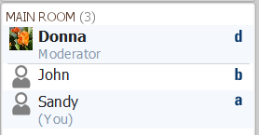
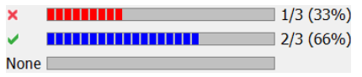
Poll Responses
Yes – No responses
Multiple Choice responses
Responses published to the Whiteboard

Slide 26



Favorite Ice Cream Moment
A B C

Slide 27
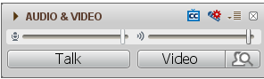
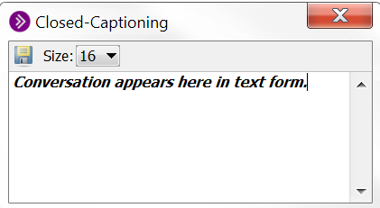

Closed Caption
Captioner adds icon to the session
Click CC icon to open Closed-Captioning window

Slide 28
Sharing Content
Whiteboard Tools
Upload Slides & Images
Application Sharing
Web Tour
Timer
File Transfer
Video Camera

Slide 29
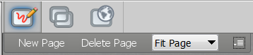
Whiteboard Window
Whiteboard window
1 2 3
1 - Add a new Whiteboard screen
2 - Delete a slide or added Whiteboard screen
3 - Increase / decrease Whiteboard screen size
Option: View > Whiteboard

Slide 30

Whiteboard Tools
Stop use of a tool / select screen objects
Choose a Whiteboard pointer
Select a pen or high lighter color
Enter text on the Whiteboard
Draw closed rectangles or circles
Draw open rectangles or circles
Draw a straight line in any direction
Desktop screen capture to place on Whiteboard
Select Whiteboard backgrounds or add clip art
Note: Go to Global Permissions to give tools to participants.

Slide 31
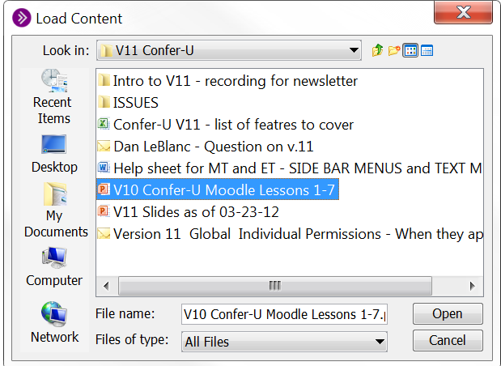
Load Content
Load PowerPoint and OpenOffice files to Whiteboard
Shortcut: Drag & Drop files here. Load content, File Transfer, open Multimedia Library.
Locate the file
Click Open

Slide 32
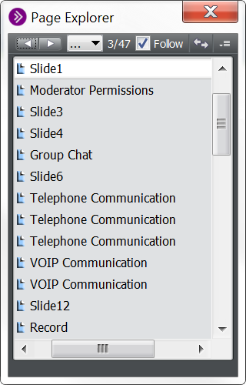
Show Slides
‘Page Explorer’ opens after slides are loaded
p
Option: Close the ‘Page Explorer’ window and
Navigate using the arrows
Note: Use ‘Page Explorer’ to delete a slide from the group
Re-open ‘Page Explorer’

Slide 33

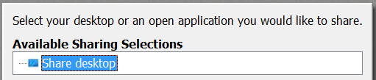
Application Sharing: Share Desktop
Launch ‘Available Sharing Selections’ window:
Option: Tools > Application Sharing
Navigate to any program on your desktop – anywhere in your computer

Slide 34
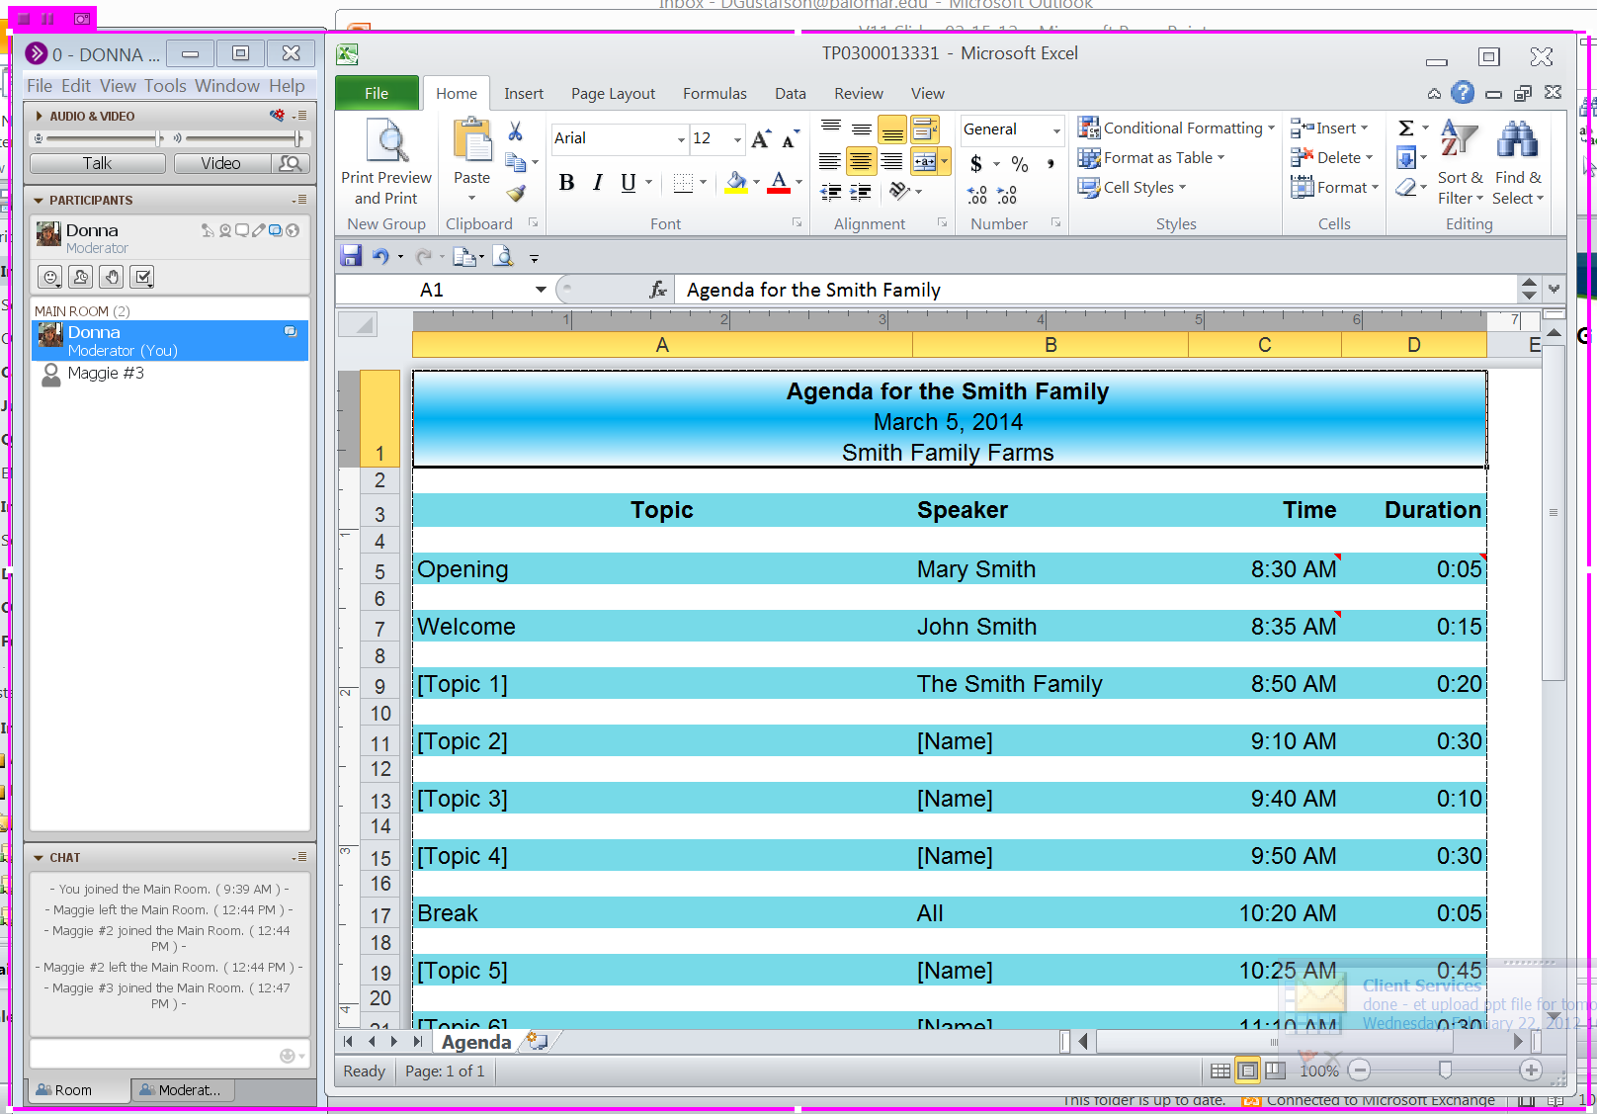
How ‘Share Desktop’ Appears to Participants
Participants see everything inside the color framed area

Slide 35



Hide the Sidebar: In ‘Share Desktop’ Mode
Click to drop the sidebar to your taskbar
Or… Grab the color frame handle – pull to the right to hide the sidebar view
From your desktop taskbar, click to bring the sidebar back into view
Option: View > uncheck Show Sidebar

Slide 36
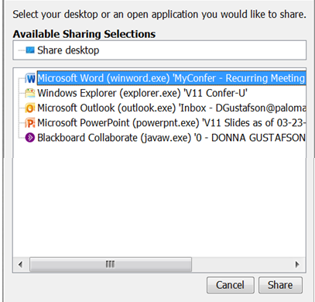
Application Sharing: Individual Apps
Launch ‘Available Sharing Selections’ window:
Option: Tools > Application Sharing
Select Applications
Use CTRL key to select multiple applications
Click Share

Slide 37
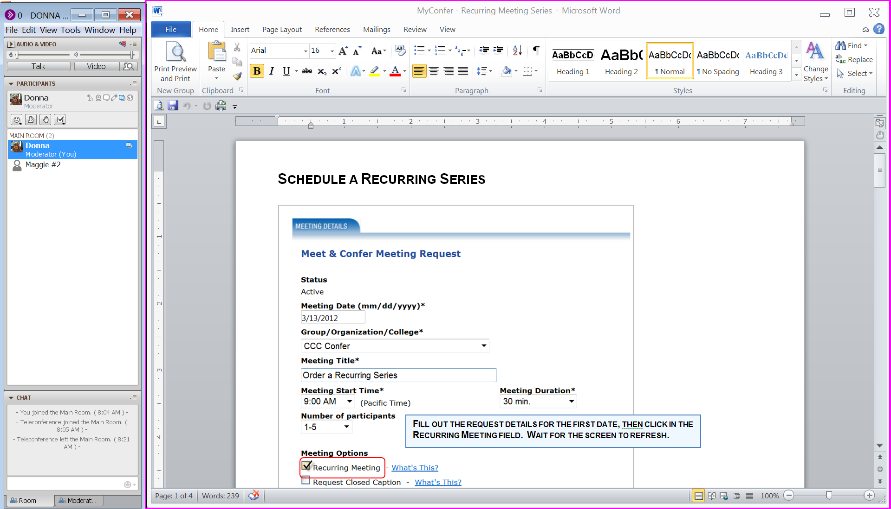
How Individual Apps Appear to Participants
Participants see everything inside the color framed area
Tip 1:
Size the App to be less than full screen before sharing
Tip 2: If application covers your screen, double click on the app title bar for automatic resize

Slide 38
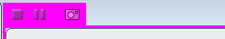
Basic Sharing Options
1 2 3
Note: The icon group may appear in upper or lower corners of the screen.
While in the Sharing Mode:
1 Stop sharing
2 Pause sharing
3 Snapshot shared app to your Whiteboard
Option: Tools > Application Sharing > Choose option

Slide 39
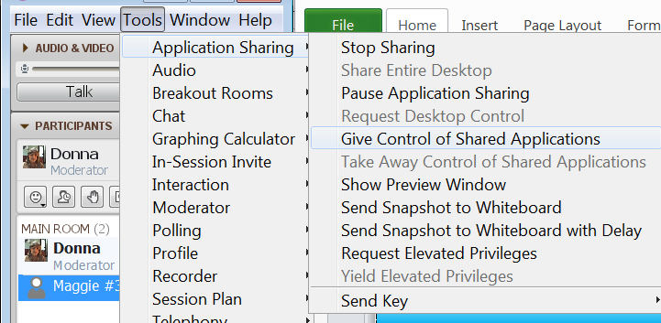
Allow Access to Shared Programs
Step 2
Step 3
Give or Take away access to shared application
STEP 1
Click on the name of the person to give access to the shared program.

Slide 40

Web Tour
Open Web Tour window
Enter or change url
Send url to Chat
Stop sharing & return to the whiteboard
Note: When websites require a password use Application Sharing.
Option: View > Web tour

Slide 41



Timer
Select Timer options
Click Start
Timer displays on the top of the screen & closes when time elapses.

Slide 42
File Transfer
Send a virtual handout to everyone with one step!
Files are uploaded to the room and offered to everyone.
Files are offered to those visiting the archives.
All participants can save the file to their desktop.
Up to 10MB can be file transferred.
When capacity is reached, delete a file so more can be transferred.

Slide 43



File Transfer Library
Shows all transferred file .
transfer a file
transfer a website file
Save a file
Delete a file from library
Prompt participants to save the file
1 2 3 4 5
Note: 10 MB capacity. Delete a file before transferring another file.
Shortcut: Drag & drop files onto the bar.

Slide 44

Audio & Video Panel: Video
Plug in a web camera and create the ultimate online human connection. Turn on video for a moment, or keep it on for the entire meeting.
Live video plays for all.
Great for introductions, demonstrations, or hands-on classes such as culinary arts!
In a hybrid meeting, create a connection between the live audience and online participants.
Up to 6 cameras can be displayed simultaneously.

Slide 45


Audio & Video Panel: Video
Click to open the video window Opens in preview mode
Click to start / stop video
Indicates who is transmitting video

Slide 46

Audio & Video Panel: Video Options
Allow up to 6 video cams to transmit video at the same time.

Slide 47

Convert CCC Confer archives to portable formats used with media players,
iPhones and iPods!
Video podcast: View a movie file with just content and audio.
Audio podcast: Listen to only the audio.
Confer Unplugged: Stand-alone view of the archive (no internet required).
Contact CCC Confer Client Services at clientservices@cccconfer.org to request the download key and instructions.

Slide 48
Support & Resources
Live Support
CCC Confer Client Services
Monday – Friday 8:00 am – 4:00 pm
760-744-1150 ext 1537, 1554 or 1542
E-mail: clientservices@cccconfer.org
Resources
TRAINING CENTER
Recorded Training
Demo Rooms
Features
SUPPORT
Technical Support
Quick Reference Guides
Features

Slide 49
Ice Breakers
Ice breakers are easy ‘get to know-you’, team building, or just a moment of fun activities.
Use ice breakers as a warm-up for lesson plans, incorporating your subject matter.
A way to ease meeting jitters when a new group gets together, especially students.
A online instructor asked his students for a picture, and now opens with a collage, including their names. Now everyone feels a bit more connected.
Create a connecting bond from meeting to meeting.
A presenter shared a picture of his new tomato plant. Each week he showed the plant progress, which prompted a few minutes of fun conversation before the start of rigorous meetings.
Other Ideas…
Post a map and everyone points to where they are right now.
On a blank screen everyone types one word about their experience on the subject matter.
Post a multiple choice question on the Whiteboard and have everyone answer using the Polling tools. Could be serious inquiries presented in a fun way.
Many web sites offer ideas. Here is one that focuses on ideas for adults in education. http://adulted.about.com/od/icebreakers/Ice_Breakers.htm

Slide 50
More Features…
Notes Window
Multimedia
Preferences: Audible Notifications & Activity Window
In-session Invites
Breakout Rooms

Slide 51

Notes Window
Take personal Notes that stay with your computer and can be read in any CCC Confer session, a great single reference point for all your notes.
Access all Notes from previous sessions.
Edit Notes at any time, even when viewing an archive.
Export Notes to others to upload on their computer.
Save Notes to a text file that can be read outside of the CCC Confer room.
This feature is available to all Moderators and Participants.

Slide 52


Notes Window
1 2 3 4 5
1 Show / hide list of dates
2 Export Notes
3 Import Notes
4 Change font size
5 Trash selected notes

Slide 53

Take Notes
Click menu bar icon to open the Notes window. This is a floating window you can move anywhere on your desktop.
As you type your notes, the text auto wraps to the next line. Hit the enter key to start a new section of notes. Notes are automatically dated.

Slide 54

Edit Notes
Click to open a date list. Select the date you want to view, or to edit.
Trash notes from a selected date.
The hand lets you know which Note you have selected for editing. Use the “Size” drop-down to change font size for all text. Highlight a section and use CTRL + or – to change selected font size. CTRL B for bold, CTRL I for italics, CTRL U to underline.
Click and hold the the hand to drag notes to a new position in the window.

Slide 55




Import / export Notes
Export Notes save your Notes to a location on your computer. File type is*.eln for importing to another computer.
Select file type .txt to open outside the CCC Confer room.
Import Notes to upload saved *.eln files to another computer. E-mail the file to a colleague who missed the live meeting, and they can Export Notes to their computer.

Slide 56
Multimedia library
Loading files before Participants join the session.
Files upload from the Moderator’s computer to a server.
Files automatically download from the server to each computer.
Participants must have the matching player for the file type.
Supported files: Flash, MPEG, MP3, MPEG4, QuickTime, WMB
File size max: 100 MB

Slide 57


Multimedia tools
Load files
Stop Play
Load URL
Play File
Remove File

Slide 58



Load Multimedia files
Locate files
Click to open
Upload status to the server.
Download status to Participants’ computers.

Slide 59



Play Multimedia Files
Select a file – click Play icon
Green Progress bar indicates file is ready
Appropriate warning messages appear

Slide 60



Preferences: Audible notifications
Preferences stay with the computer.
Everyone can set preferences.
Select options
Apply - OK

Slide 61



Preferences: activity window
Select options
Apply - OK

Slide 62


View Activity window
Filter event viewing
- A scrolling timeline of session events
- Slide text and chat messages appear
- Screen reader supported.

Slide 63


In Session invites
Send Participants a direct link to the meeting.
Opens your email
Address & send the link

Slide 64
Break out rooms
Create separate rooms for small group activities.
Set up rooms on the fly, or before the meetings begins.
Place Participants into a room.
Move Participants between rooms.
Each room uses the same feature set as the main room.
Assign Moderator privileges as needed.
Activities in Breakout Rooms are not included in recordings.
Use VOIP for communicating within Breakout Rooms.

Slide 65


Break out rooms
Select options and Create rooms
Note: VOIP communication is separated for each Breakout Rooms. Conference line cannot be used in a Breakout Room.

Slide 66

Break out rooms: Place participants in rooms
Click the drop-down next to a person’s name. Choose a room.
Shortcut: Click a name to drag and drop into another room.

Slide 67

Break out room: Options
Click the drop down next to the Break Out Room

